Slide 1

Clup
APPLICATION OVERVIEW

Slide 2

What is Clup?
THE PROBLEM
Back when shop accesses where slotted,
people crowded outside.
THE SOLUTION
Allow people to book shop reservations.
Reduce waiting time
Mitigate crowding risks

Slide 3
Supported devices
API
22
23
24
25
26
27
28
29
30
Reach ~92% of devices

Slide 4
Architecture • OVERVIEW
Auth
Activity
Name
Fragment
Phone
Fragment
Code
Fragment
Success
Fragment
Details
Activity
Main
Activity
Map
Activity
Select
Activity

Slide 5
Architecture • MVVM
Local storage
SMSAuthService
Model
QueueService
MapsService
AuthViewModel
AuthActivity
FragmentCode
FragmentPhone
MainViewModel
MapViewModel
SelectViewModel
DetailsViewModel
FragmentName
MainActivity
MapActivity
SelectActivity
DetailsActivity

Slide 6
Async execution • UI
VIEW UPDATE
ANONYMOUS UPDATE
view.post(() -> {
});
new Handler(Looper.getMainLooper())().post(() -> {
});
Single status update
ViewModel update
UI updates in background threads

Slide 7
Async execution • BACKGROUND
UI CALL
WORKER
interface Callbak {
onComplete(Result result);
}
worker.doAction(params, result -> {
});
ExecutorService executor =
Executors.newSingleThreadExecutor();
doAction(Params params, Callback callback) {
executor.execute(() -> {
result = apiCall(params);
callback.onComplete(result);
});
}
Interaction with remote API

Slide 8

External API • SMS AUTH
GET
https://verify-****.twil.io/start-verify?to=TO&channel=sms&locale=LOCALE
•••
GET
https://verify-****.twil.io/check-verify?to=TO&verification_code=CODE
OK

Slide 9

External API • QUEUE
id
name
opening_days
GET
https://mobile-project-****.twil.io/business/list
BUSINESSES
business_id
date
hour
GET
https://mobile-project-****.twil.io/queue/list
USERS
POST
https://mobile-project-****.twil.io/queue/enter
uuid
STATUS
user_fullname
business_id
date
hour
RESERVATION

Slide 10
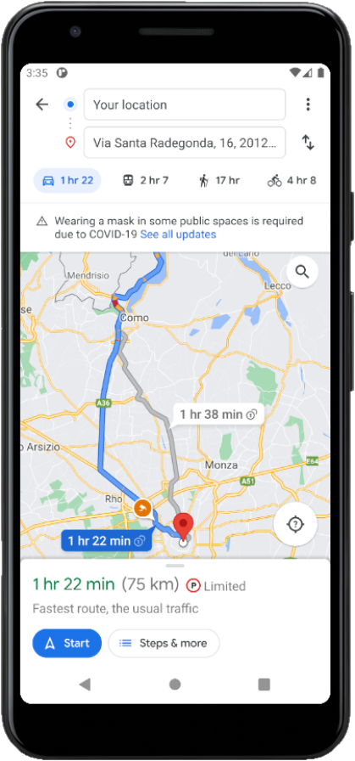
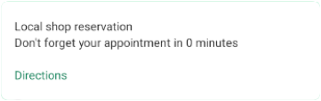
External API • MAPS
GET
https://www.google.com/maps/dir/?api=1&destination=LAT,LNG
Navigation from current location to LAT-LNG

Slide 11




Test
UI - UX
UNIT TEST
INSTRUMENTATION TEST
API 22-26-30
JUnit 4
JUnit 4
Manual, 50 h

Slide 12
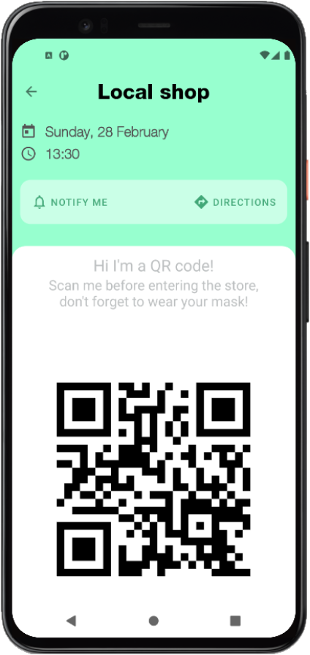
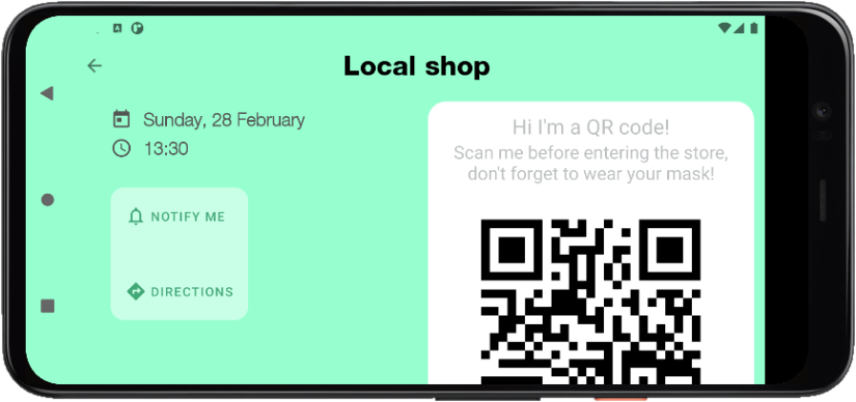








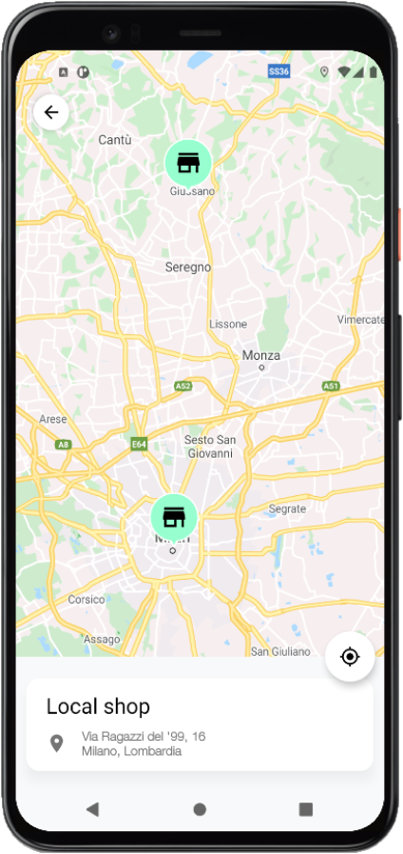
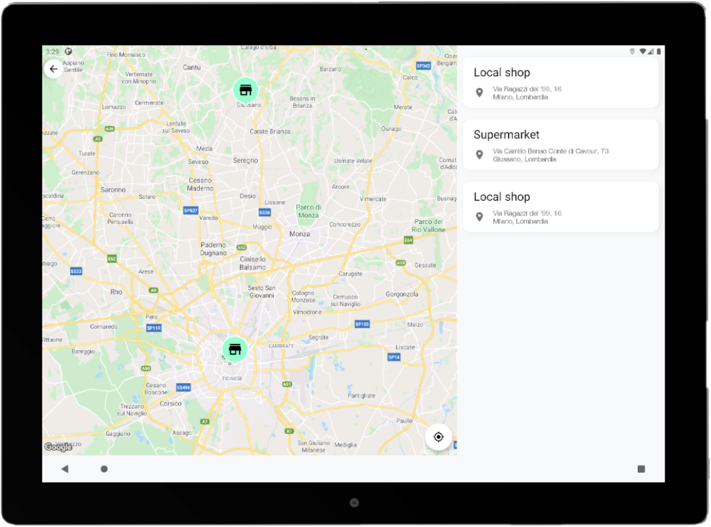

Nice to have
Landscape layout variations
AndroidX (Jetpack) framework
LiveData
Tablet layout variations
Multi language support
Dark Theme Support

Slide 13
THANKS

